Slide 1

Jhenaidah Sadar Hospital Model Developed by Local Initiative.

Slide 2
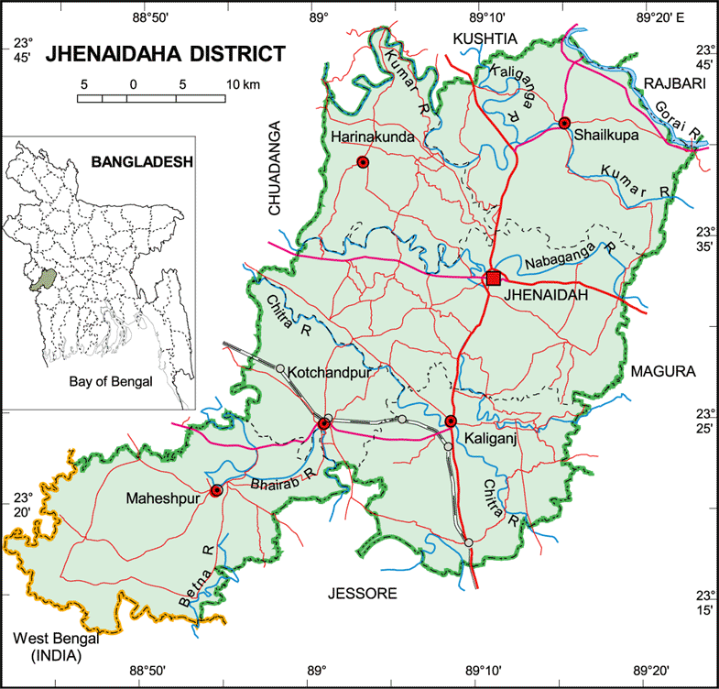

Slide 3
A District level Women-Friendly Hospital with a Vision …
Maximum utilization of Govt.
resources with
honesty and sincerity.
Integrated approach of
Administration, Community
Leaders .
Providing Effective services
through improved
management system.

Slide 4
Background History of Jhenaidah Sadar Hospital
Jhenaidah Sadar Hospital was established in 1968 as Sub-Division Hospital and became functioning from December 1970.
- From February 1984 recognized as District Sadar Hospital.
- In 1994 upgrade to 100 Bedded Hospital without manpower & infrastructure.
- In May 2005 infrastructure of 100 beded hospital completed.
- In 2008, Laparoscopic surgery was initiated in Hospital.
- In 2010 , this Hospital was awarded for EOC Activities, in Khulna Division.
- TQM activities started in January 2011 and effectively in May 2012.
In 10’th October foundation stone for 250 bedded hospital is established by Honorable Prime Minister of Peoples Republic of Bangladesh.
- In 9 Feb, 2014, 5S KIZEN – TQM program started by DGHS & SMPP JICA.

Slide 5
Comparative data of HR of different SEARC countries(Doctors , Nurses & Midwives)
World Health Bulletin 2022

Slide 6
Health Profile of Jhenaidah District- 2015
Population : 1857149
Pregnant mothers : 38074
Total Live birth : 36465
U5 children : 222120
No. of Upazilla : 06
Paurasava : 06
Union : 67
Govt. Health Institutions : 253
a) Sadar Hospital : 01
b) Upazilla Health Complex : 05
c) H&FWC/ RD (57+13) : 70
d) Community Clinic : 171
e) NTC+IHT +MATS(1+1+1) : 03
f) Sishu Hospital (25 bed) : 01
g)MCWC :01
9. Non-Govt. Health Institution : 116
i) Diabetic Hospital : 01
ii) Eye Hospital : 01
iii) Private Clinic (Regd.) :114

Slide 7
Sadar Hospital, Jhenaidah
Important post of Human Resources
Serial No. | Person | Post | Vacant
01 | Doctor | 40 | 21
02 | Nurse | 48 | 00
03 | MLSS | 10 | 0
04 | Ward boy | 03 | 03
05 | Ayah | 03 | 03
06 | Cleaner | 07 | 00
07 | Guard | 03 | 00
08 | Gardener | 01 | 00
09 | Electrician | 01 | 00
10 | Others | - | -
 | Total | 151 | 31

Slide 8

Sadar Hospital, Jhenaidah
Bed Occupancy Rate from 1998 to 2017

Slide 9
Emergency & Out Door, Indoor Service 1998 to 2017
Sadar Hospital, Jhenaidah

Slide 10
3 best performing EmOC Hospital in Khulna division - 2017
Sadar Hospital, Jhenaidah

Slide 11
Operation Service (Major) 2011 to 2019
Sadar Hosital, Jhenaidah

Slide 12
Community Support System in Sadar Hospital
Staff : 53
  Cleaner: 20
  Aya /Word boy: 21
  Security guard: 6
  Volunteer: 3
  Trolley man: 3
Generator.
Intercom.
Biochemical analyzer.
Reformation of medicine, surgery, pediatric word.
Boundary wall repair.
Pic up car.
Donors:
MP.
Mayor.
Zahedee Foundation.
Doctors.
Other donors
Retd. Secretary .

Slide 13


Innovative activities of Hospital
Health Education for the patients and their attendance by health Manager.
Motivation of the community leaders .

Slide 14


Visit to Shatkhira District Hospital and Introduction of TQM activities
A team of Jhenaidah District hospital visited to Shatkhira District hospital in 2014
A meeting was held in Shatkhira District conference room

Slide 15




Changes in EOC Ward
Before
After
Before
After

Slide 16





Changes in Gardens of The Hospital
Before
After
Before
After

Slide 17







Changes in JhenaidahSadar Hospital(Padeatric ward,Waste Management)
Before
After

Slide 18




KAIZEN in Jhenaidah Sadar Hospital
Color code
Color code
Use of direction sign
waist segregation

Slide 19




Improved pediatric word by local initiative

Slide 20
Achievements of Jhenaidah Sadar
Hospital
1. Active Community Participation is an example in Bangladesh.
2. Improved performance of all services.
3. Improved Cleanliness and Beautification of Campus.
4. Functioning of X-Ray service and Biochemistry investigation. .
5. Improved Security.
6. Improved Financial Management
7. Piloting of “Model District Hospital” is running in Jhenaidah Sadar Hospital.
8. The hospital is awarded 5 times from 2013 to 2017.

Slide 21
Challenges of the Hospital
Many post of doctors ,3rd and 4th class employees are vacant.
A accommodation of the patients is a major problem
Waste management system is weak
4.

Slide 22
Way Forward
All vacant post of doctors and nurses to be filled
Ambulances to be replaced.
Improved X-Ray, Ultrasonogram and Pathological instruments.
Renovation and reconstruction of the hospital building.
The construction of 250 bedded hospital should be completed.

Slide 23

Thank You
Notes:
23

